Slide 1
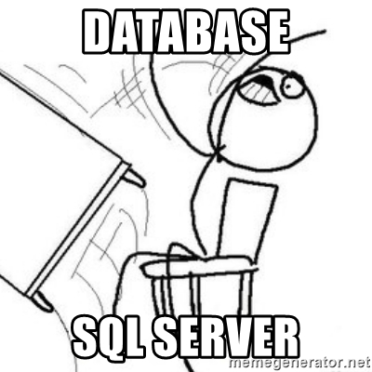
Welcome!

Slide 2
SQL Showcase
Notes:
Showcase to be done live.

Slide 3
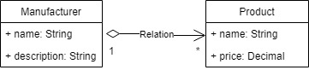
This is a basic diagram illustrating the relationship between a Manufacturer and their Products for an e-commerce database.

Slide 4

This icon indicates an activity

Slide 5
What is a database?
A shared collection of logically related data and its description.
Take a small portion of an e-commerce website as an example:
Each Manufacturer can have multiple products (one-to-many relation). Since this structure makes sense for an e-commerce website, the data in the example is logically related.

Slide 6
What is a database? Continued…
The description of the data is know as the metadata (“data about data”)
Examples of metadata in a relational database:
Tables
Columns
Data types
Constraints
Table relationships

Slide 7
What is a DBMS (Database Management System)?
A software system that enables users to define, create, maintain and control access to one or more databases.

Slide 8
DBMS – Data Definition Language (DDL)
DBMS allows the user to define the database, usually through a Data Definition Language (DDL). The DDL allows users to specify the data types, structures and the constraints on the data to be stored.
Notes:
The DDL is pretty much used to specify the metadata of a database.

Slide 9
DBMS – Data Manipulation Language (DML)
DBMS allows users to insert, update, delete and retrieve data from the database, usually through a Data Manipulation Language (DML). Having a central repository for all data and data descriptions allows the DML to provide a general inquiry facility called a query language.
The most common query language is the Structured Query Language (SQL, pronounced “S-Q-L”, or “See-Quel”)

Slide 10
What is SQL (Structured Query Language)?
SQL is a standard language used to perform basic data management tasks, such as the insertion, retrieval, modification, and deletion of data from a database.
These basic data management tasks are commonly referred to as CRUD:
C - Create
R - Read
U - Update
D - Delete

Slide 11
Setting up our database
We will be using MySQL. Why?
Because the download is relatively small and there is a lot of free help online. They claim to be open source, but MySQL is Free Software licensed under the GNU GPL.
There are other open source databases out there like MariaDB, MongoDB and PostgreSQL.
Important: Make sure to always checkout the licensing agreement.
Notes:
Point out this article:
https://www.xaprb.com/blog/2008/05/14/mysql-free-software-but-not-open-source/
If you go to https://www.mysql.com/ their search bar contains this ‘The world’s most popular open source database’.
Most people use the ‘free’ and ‘open source’ interchangeably.
Highlight the difference between the two by referencing the article.
All in all, don’t focus on the difference between ‘free’ and ‘open source’ this lesson is not about that. Just know that MySQL is free.

Slide 12
What does being open source mean?
Most software that you download or buy comes in the compiled ready-to-run version. This makes it difficult to modify the compiled version. Most commercial software manufacturers see this as a means to stop other companies from copying their code.
Open source is the opposite, the source code is included with the compiled version, therefore modification is encouraged.
“Given enough eyeballs, all bugs are shallow” – Linus’s Law
Notes:
Why would people give their work away for free? https://en.wikipedia.org/wiki/Linus%27s_Law

Slide 13
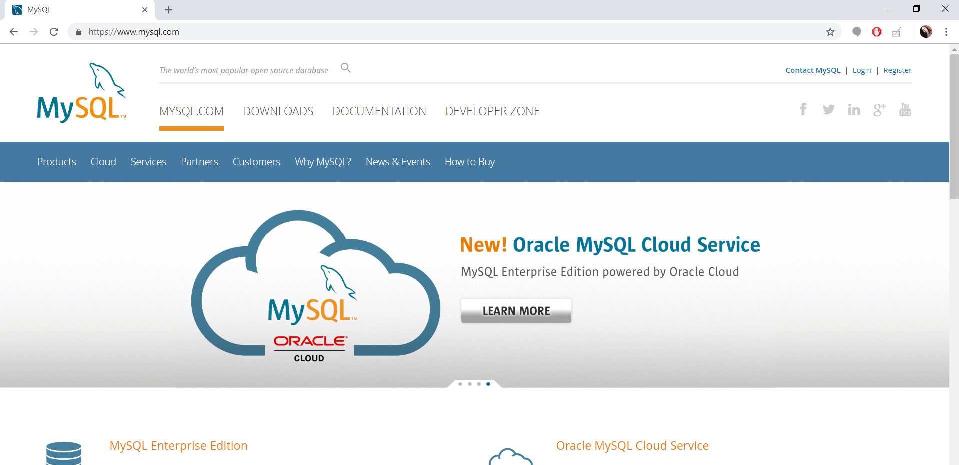
Downloading MySQL
Go to https://www.mysql.com/
Notes:
Everyone should have copied the MySQL Installer from the flash disks provided, but I will still show the process regardless.

Slide 14
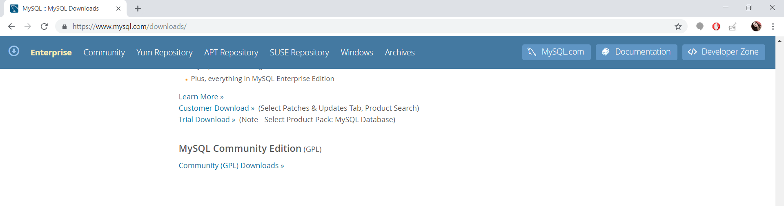
Downloading MySQL continued…
Then click on the ‘DOWNLOADS’ tab, and scroll all the way to ‘MySQL Community Edition (GPL)’.
Then click on ‘Community (GPL) Downloads »’ link.

Slide 15
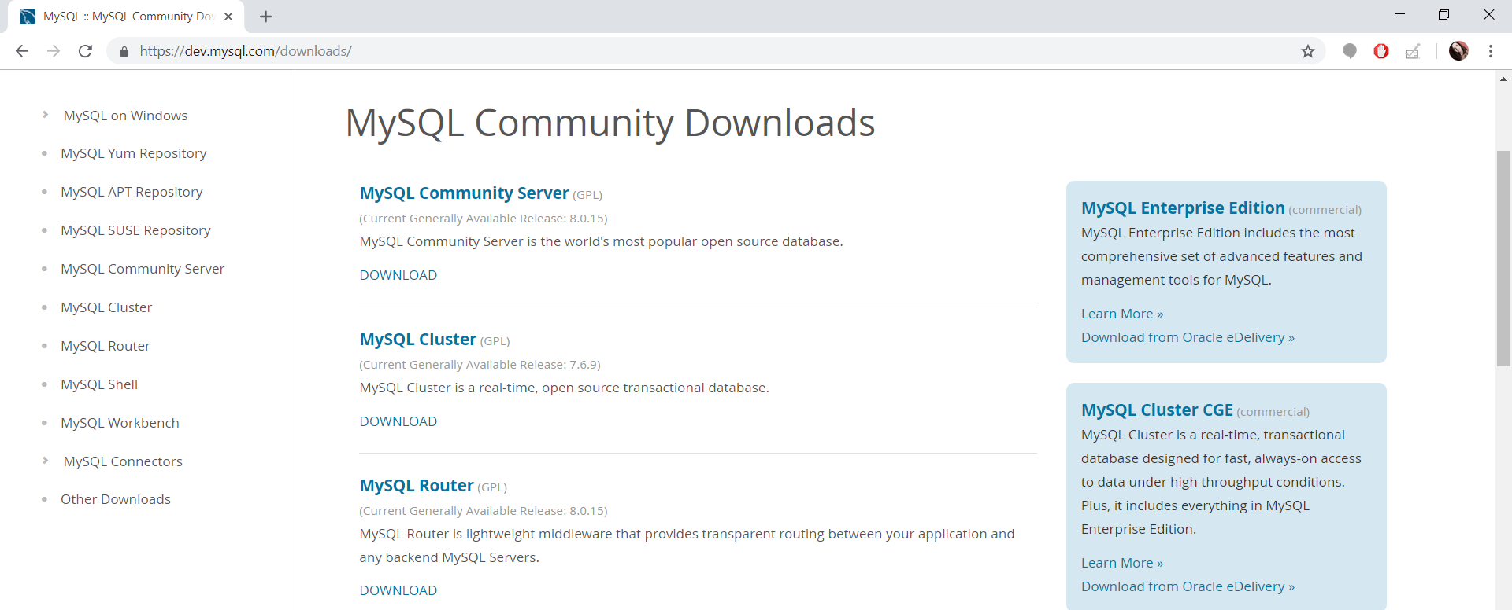
Downloading MySQL continued…
You should see a page with a couple of download options:
We want to download the ‘MySQL Community Server’, so click on the ‘DOWNLOAD’ link under ‘MySQL Community Server’.

Slide 16
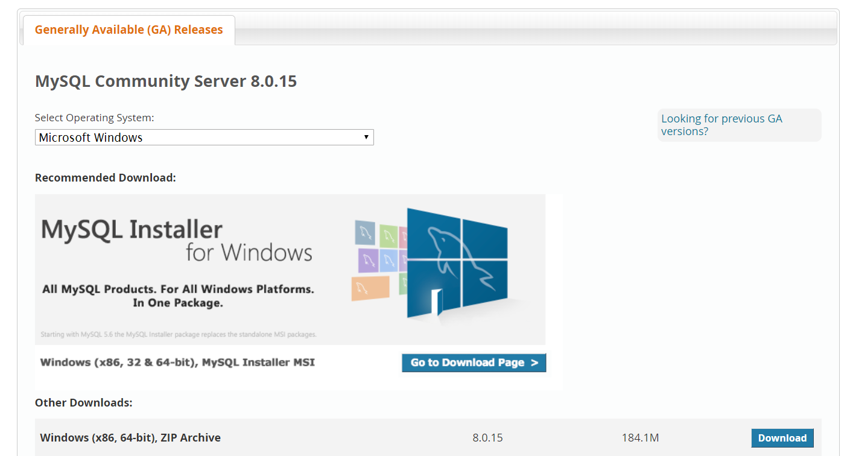
Downloading MySQL continued…
If you scroll down a little you should see something like this:
Then click on ‘Go to Download page >’.
If you are using macOS please call us so we can assist you.

Slide 17
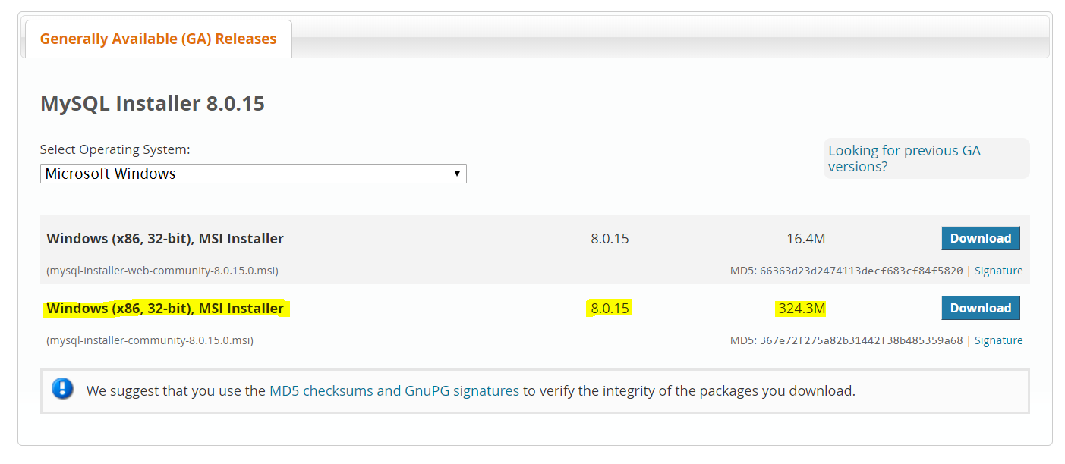
Downloading MySQL continued…
If you scroll down a little you should see something like this:
Click the ‘Download’ button for the highlighted MSI Installer.
Notes:
The difference between the two downloads is basically the smaller download will do an initial download and then download more while it is busy installing. Where as the bigger download have everything you need so it will not need to download more while installing.

Slide 18
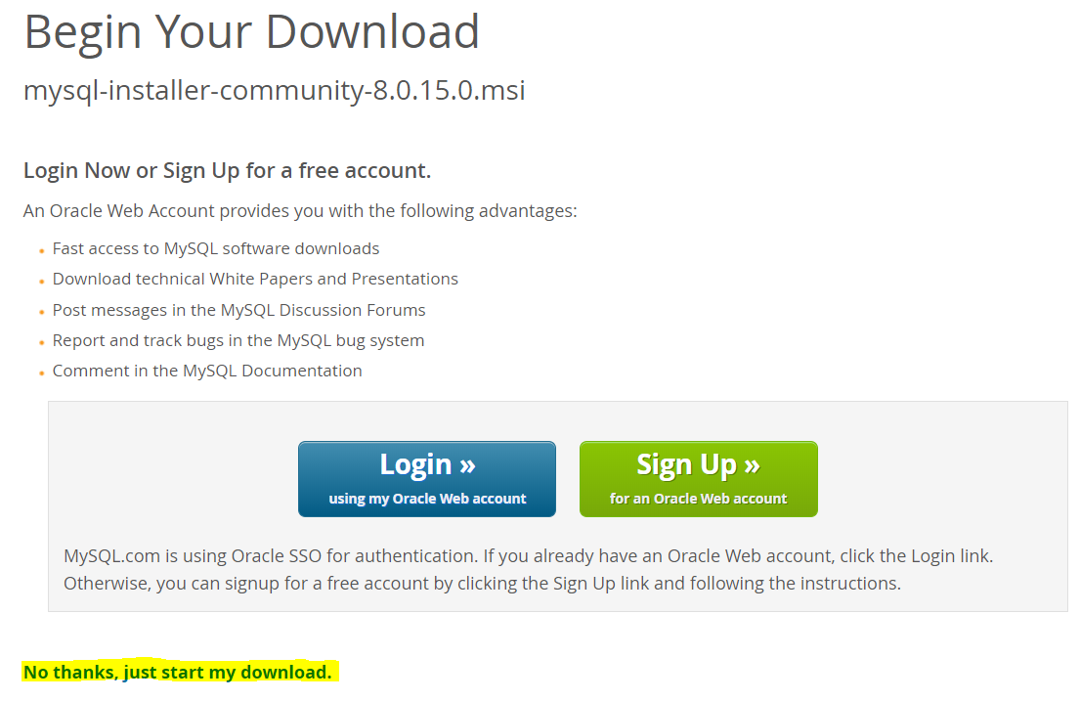
Downloading MySQL continued…
You should see something like this:
Notes:
I will have a couple of flash disks with the MSI Installer on.

Slide 19
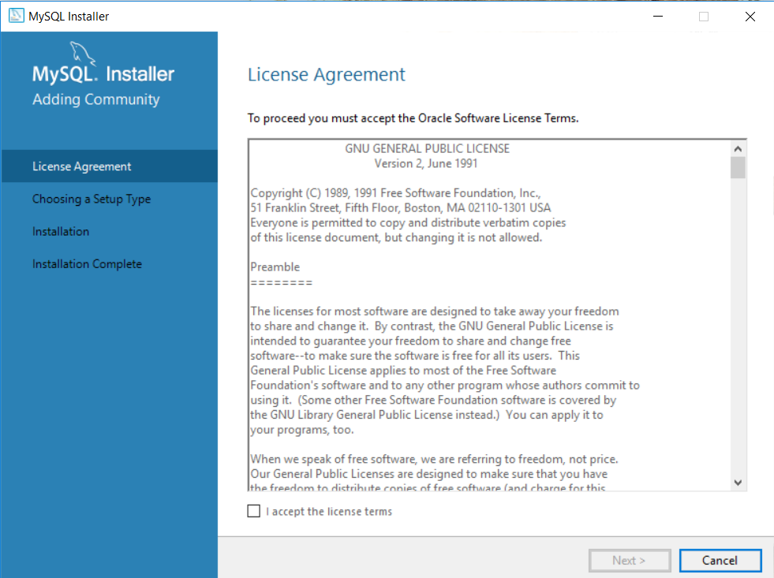
Installing MySQL
Go to your download and double click it, you should see this:
Check the checkbox for ‘I accept the license terms’. Click ‘Next’.
Notes:
If this does not pop up. Look around for a Windows notification asking for permission to continue with the installation.

Slide 20
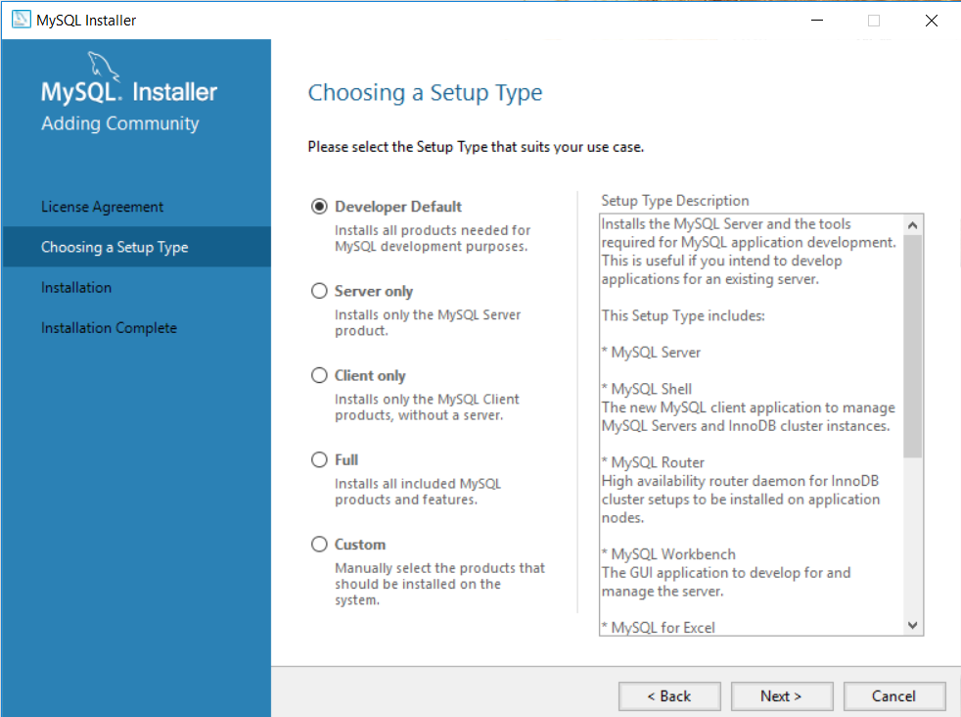
Installing MySQL continued…
You should see this:
Choose ‘Developer Default’ and click ‘Next’.

Slide 21
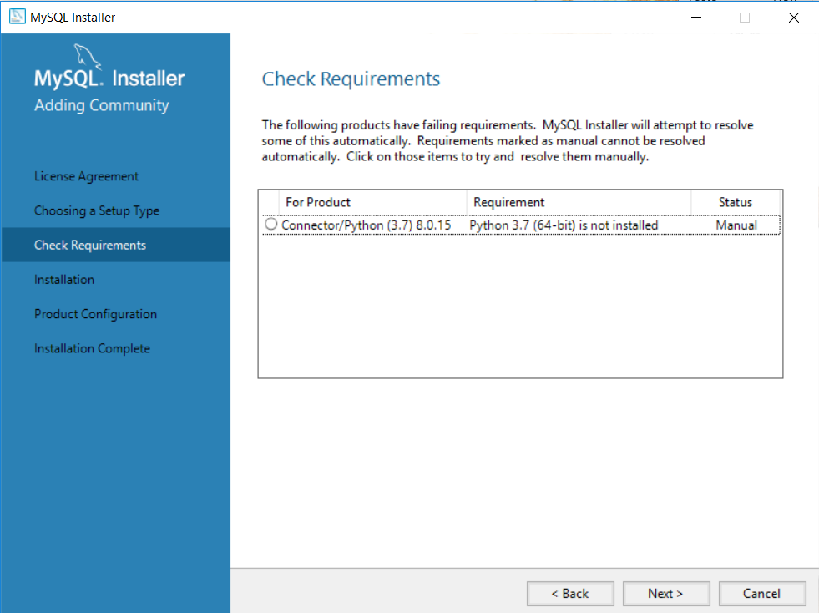
Installing MySQL continued…
You should see this:
Ignore it and click ‘Next’.
Notes:
This will ask you to resolve some requirements manually. This could happen if you don’t have other requirements installed for example visual studio.

Slide 22
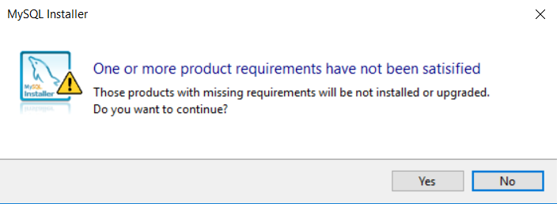
Installing MySQL continued…
You should see an alert box like this:
Click ‘Yes’.

Slide 23
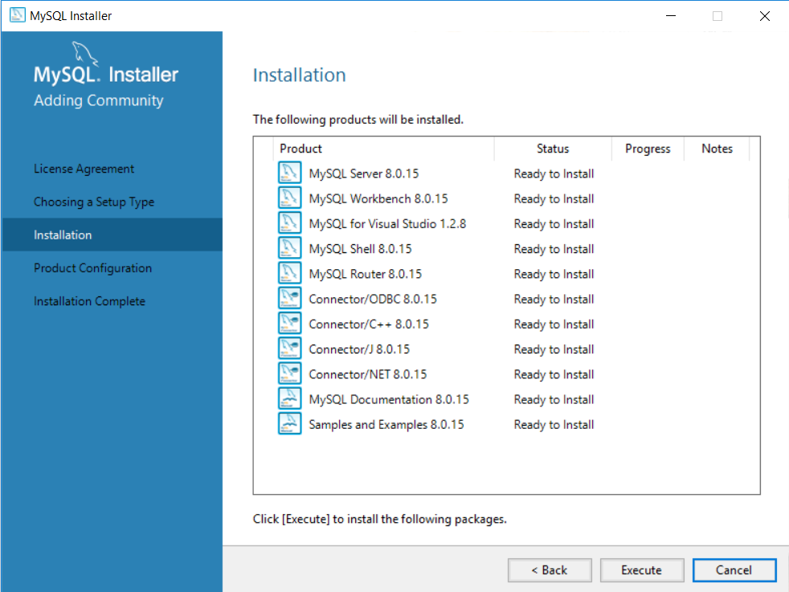
Installing MySQL continued…
You should see this:
Click ‘Execute’. It should start installing.

Slide 24
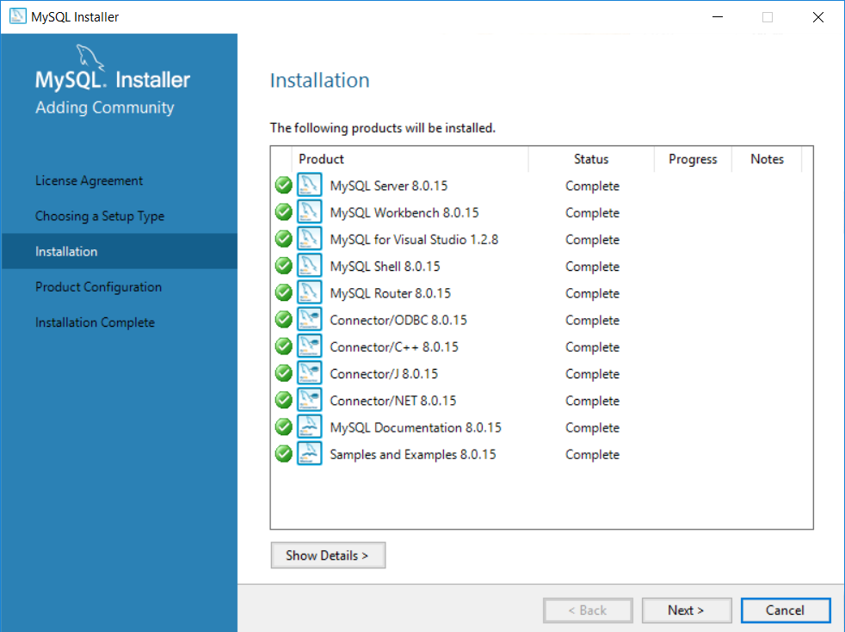
Installing MySQL continued…
Once installation is done, you should see this:
Click ‘Next’.

Slide 25
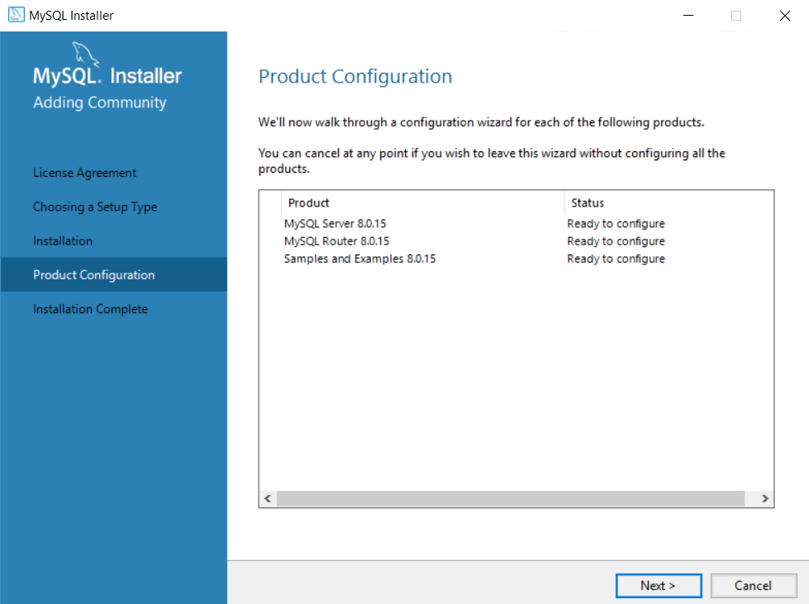
Installing MySQL continued…
You should see this:
Click ‘Next’.

Slide 26
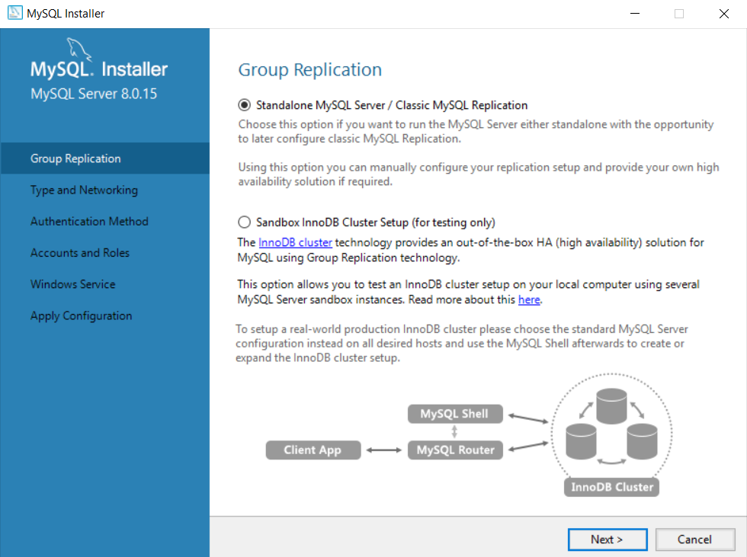
Installing MySQL continued…
You should see this:
Select ‘Standalone MySQL Server’ and click ‘Next’.

Slide 27
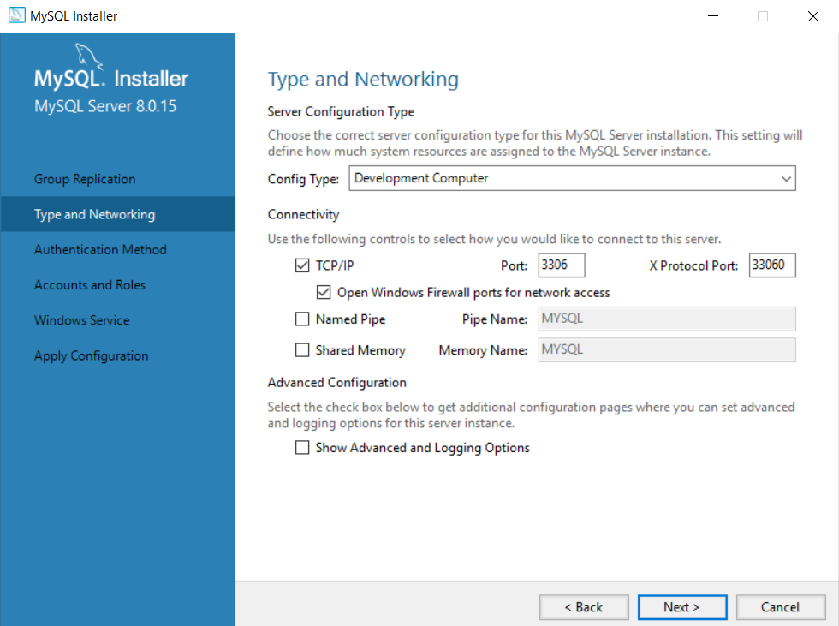
Installing MySQL continued…
You should see this:
Leave the configuration as is and click ‘Next’.
Notes:
Port 3306 is the default MySQL port.

Slide 28
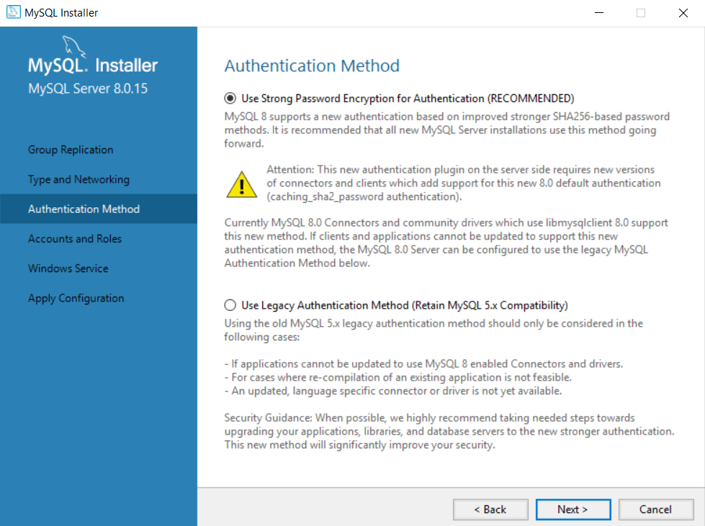
Installing MySQL continued…
You should see this:
Leave the configuration as is and click ‘Next’.

Slide 29
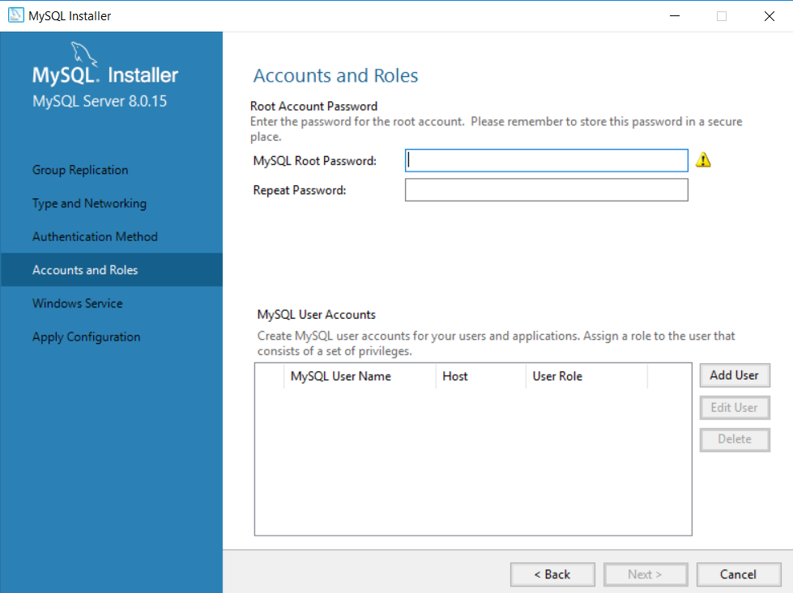
Installing MySQL continued…
You should see this:
Provide a password for the root account.
Notes:
It is important to remember this password all throughout these lessons so for development purposes keep the password simple. However it is important to use strong credentials when you use MySQL for more than development purposes.

Slide 30
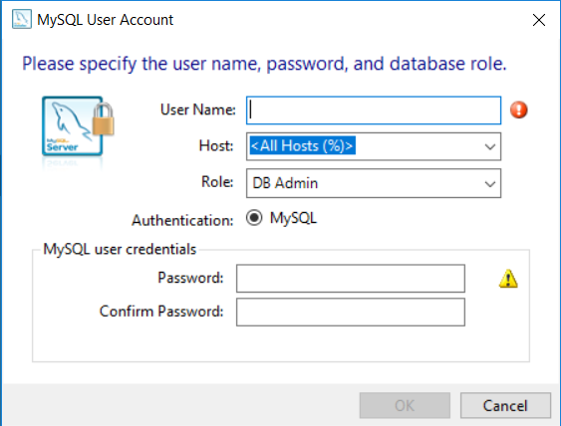
Installing MySQL continued…
Then we want to add a user account. So click on ‘Add User’, then you should see this:
Select a different username and password here and click ‘OK’.
Notes:
You will need to remember this username and password so keep it simple for development purposes. However it is important to use strong credentials when you use MySQL for more than development purposes.

Slide 31
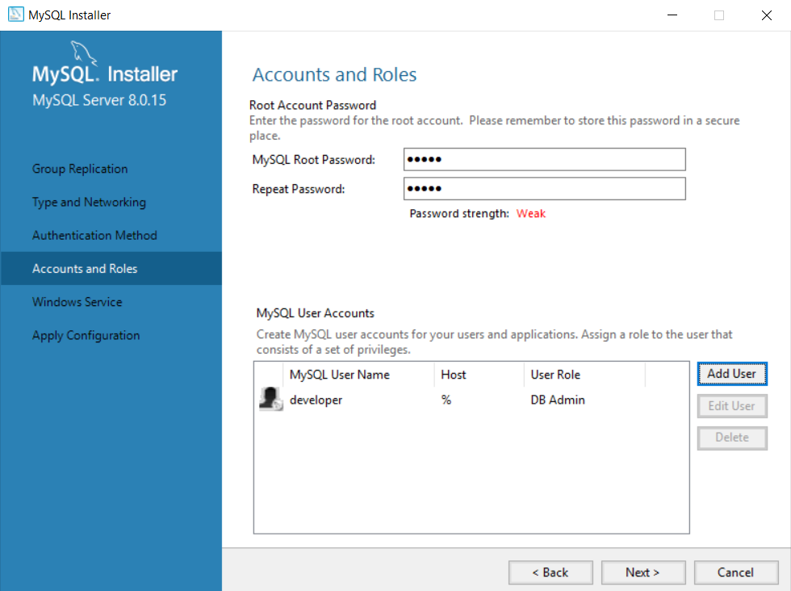
Installing MySQL continued…
Your installer view should now look like this:
Click ‘Next’.

Slide 32
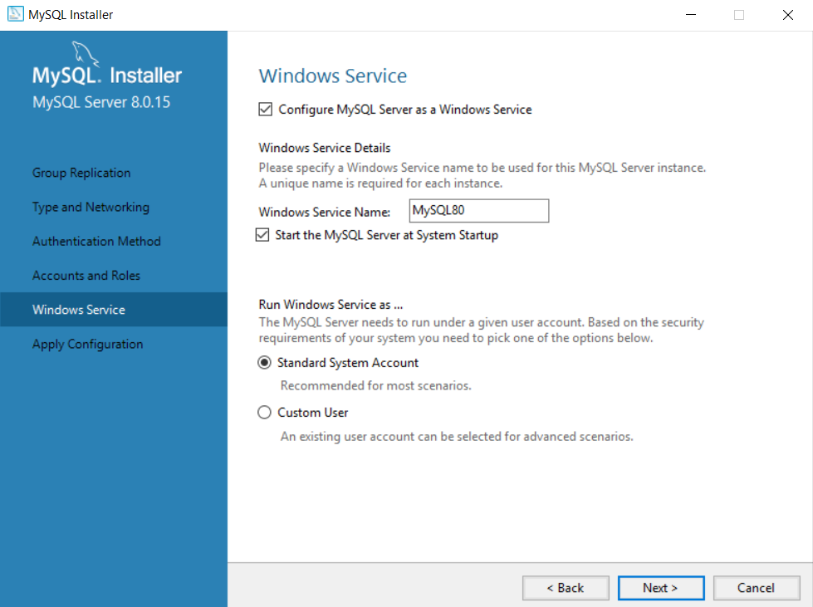
Installing MySQL continued…
You should see this:
Leave all the default configuration and click ‘Next’.

Slide 33
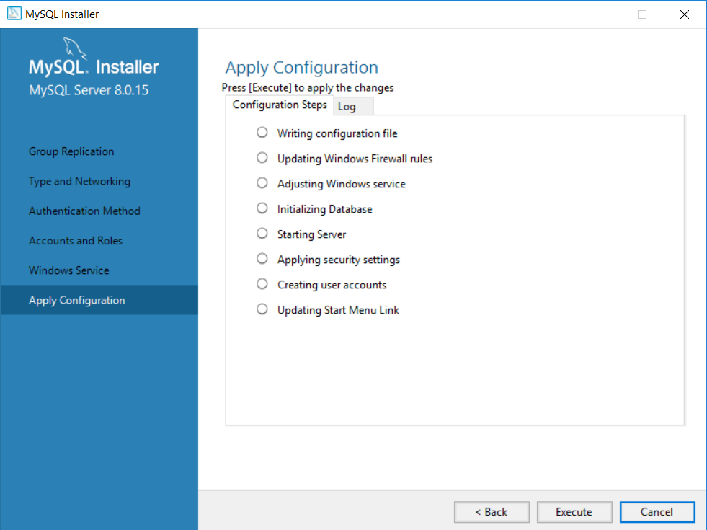
Installing MySQL continued…
You should see this:
Click ‘Execute’.

Slide 34
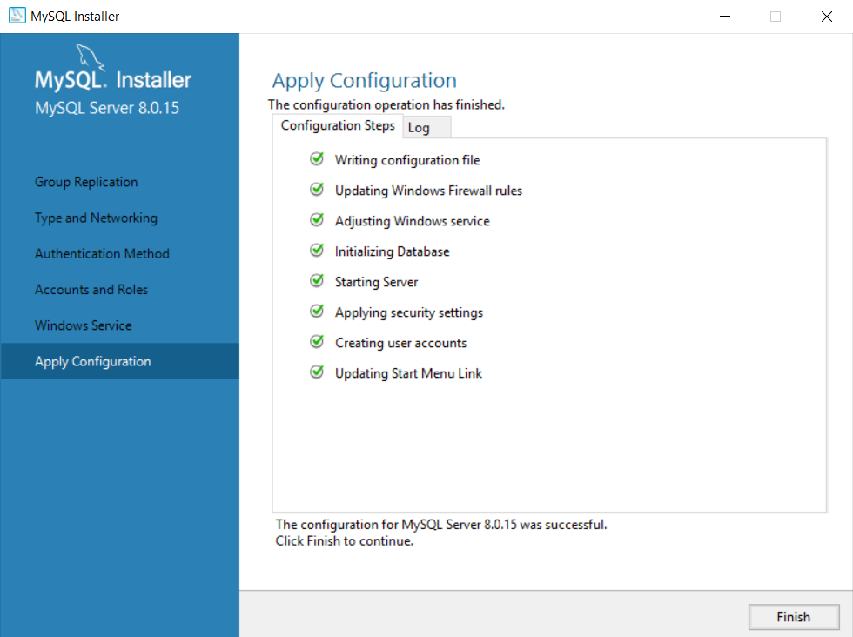
Installing MySQL continued…
Once the configuration is completed you should see this:
Click ‘Finish’.

Slide 35

Installing MySQL continued…
Then the installer will take you back to the ‘Product Configuration’ so that we can configure the other products:
Click ‘Next’.

Slide 36
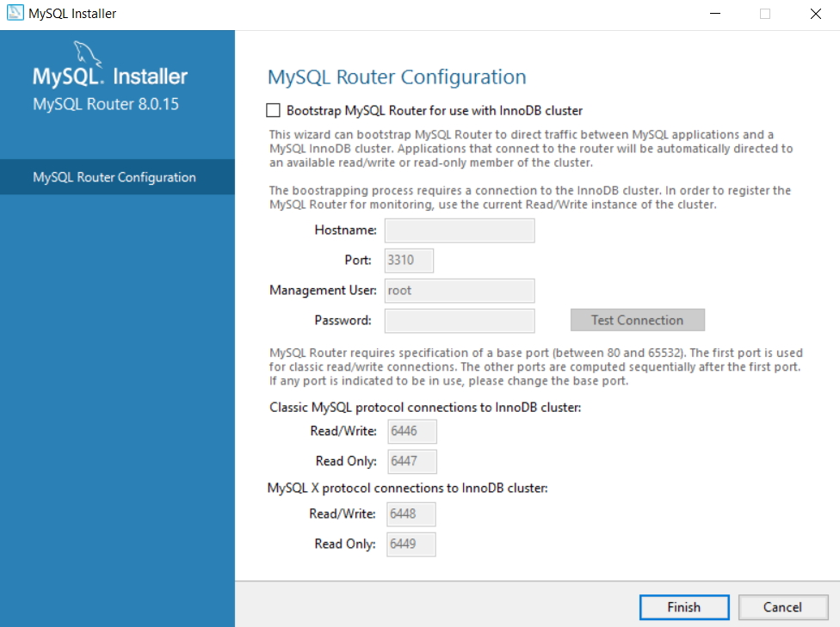
Installing MySQL continued…
You should see this:
Leave the configuration as is and click ‘Finish’.

Slide 37

Installing MySQL continued…
Then the installer will take you back to the ‘Product Configuration’ so that we can configure the last product:
Click ‘Next’.

Slide 38
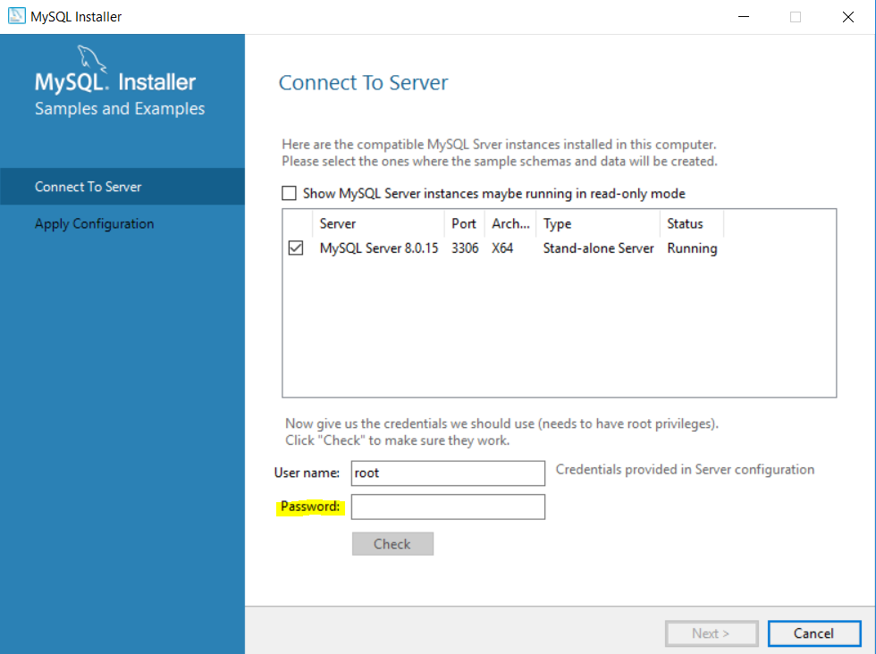
Installing MySQL continued…
You should see this:
Type in the root account password that we configured earlier into the highlighted input box and click ‘Check’.

Slide 39
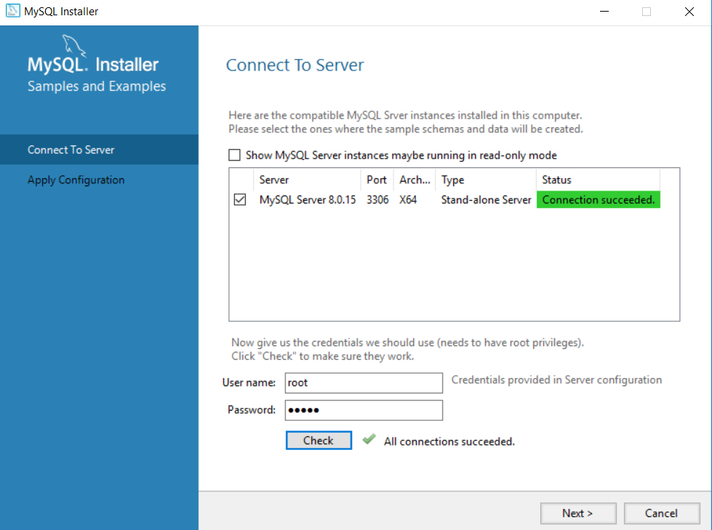
Installing MySQL continued…
If you were able to successfully connect to the MySQL server with the username ‘root’ and the root account password we configured earlier, you should see this:
Click ‘Next’.

Slide 40
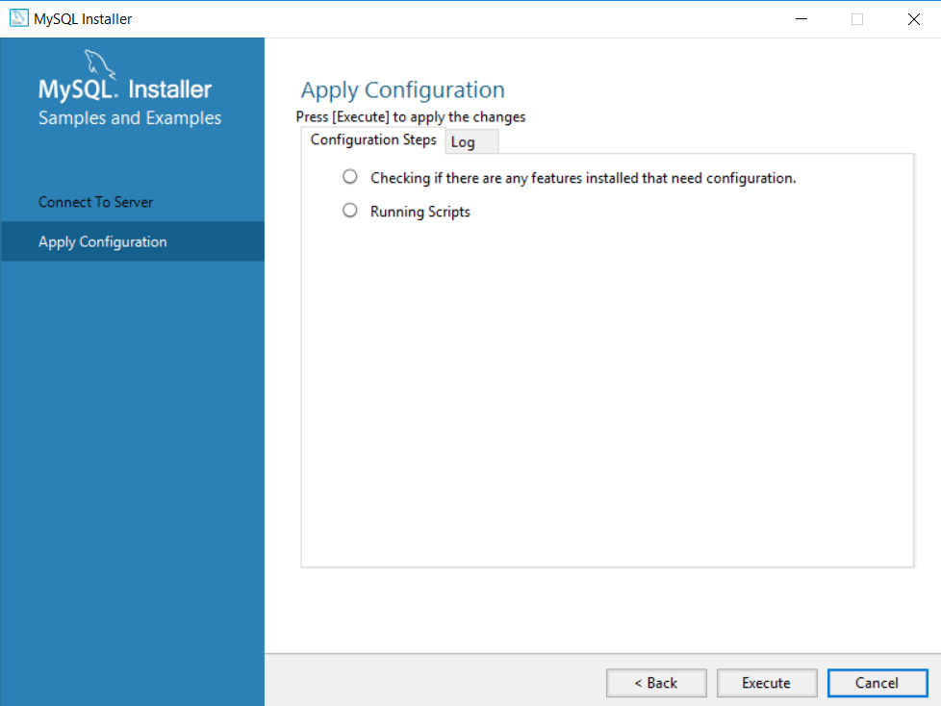
Installing MySQL continued…
You should see this:
Click ‘Execute’.

Slide 41
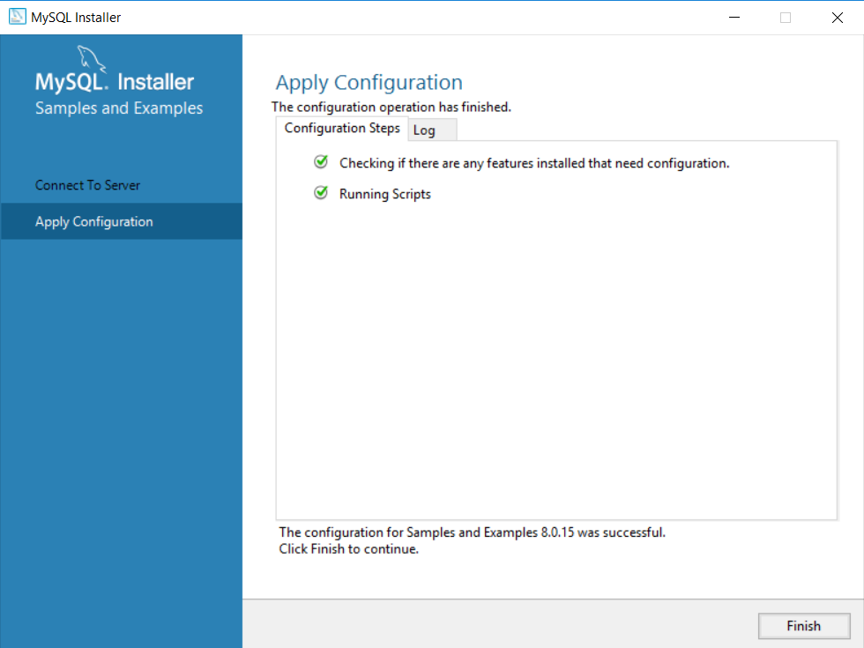
Installing MySQL continued…
Once the installer is done applying the configuration you should see this:
Click ‘Finish’.

Slide 42
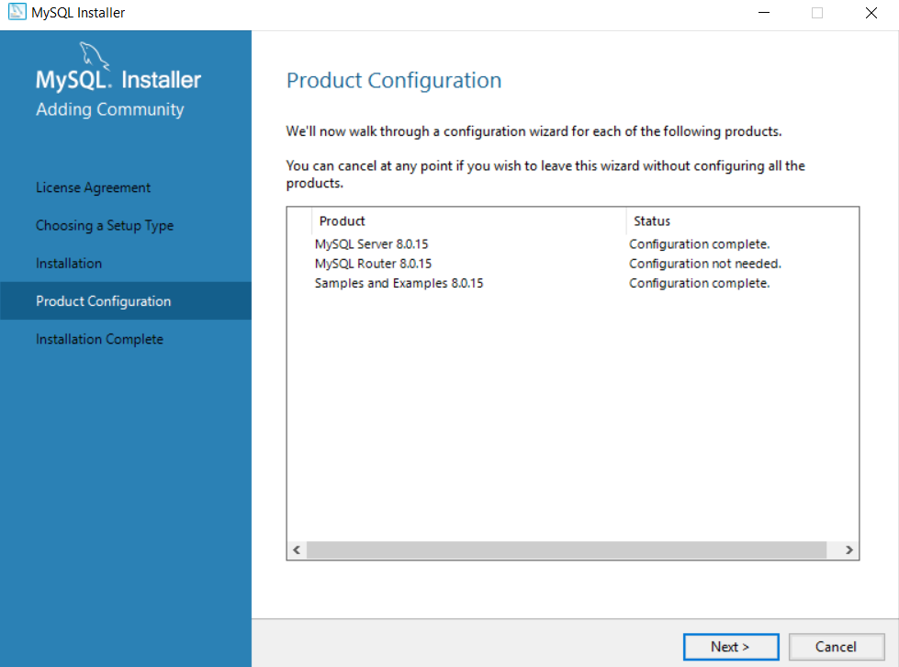
Installing MySQL continued…
Then you should be taken back to the ‘Product Configuration’ view:
Click ‘Next’.

Slide 43
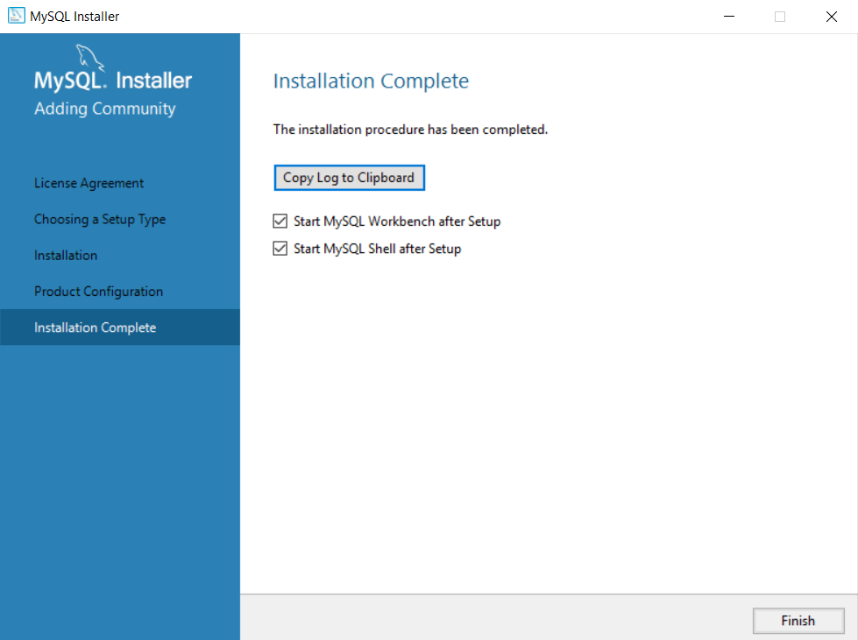
Installing MySQL continued…
Finally you should see this:
Click ‘Finish’. MySQL Workbench should then start up.

Slide 44
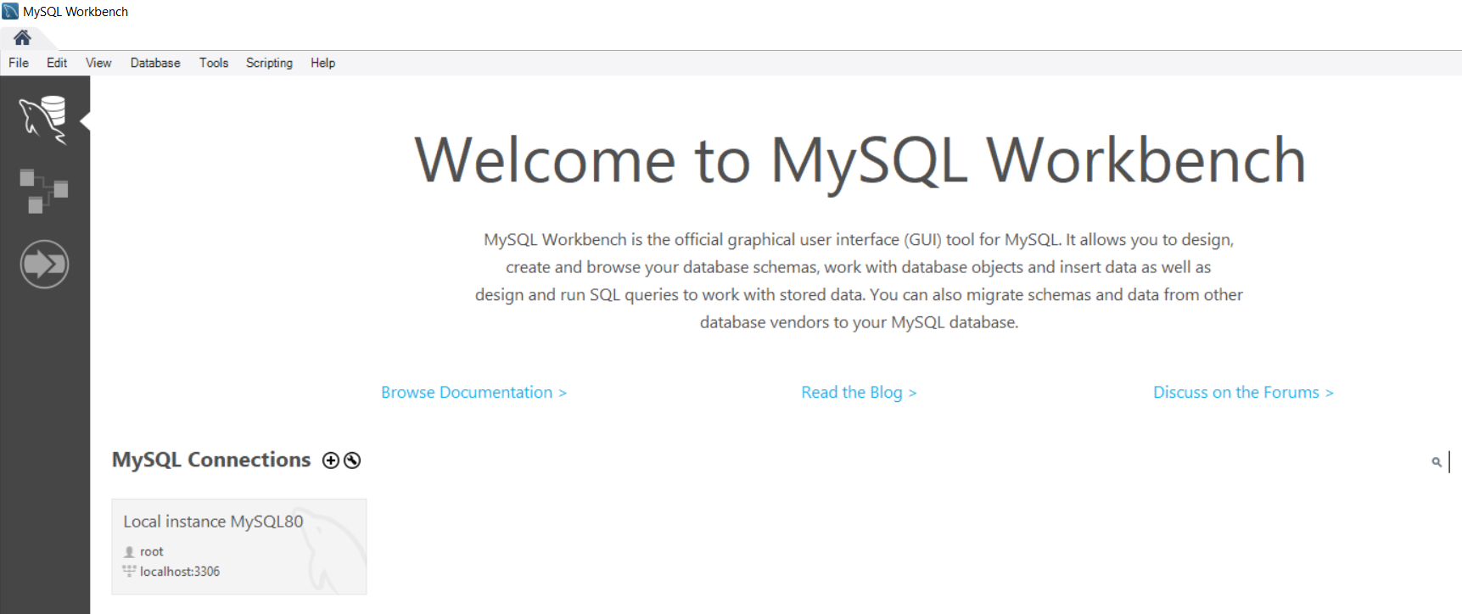
Installing MySQL continued…
When Workbench opens it will look like this:

Slide 45
SQL Create database
You can create a database with this statement:
CREATE DATABASE databasename;
‘CREATE’ and ‘DATABASE’ is in bold because they are keywords that you use to tell MySQL server that you want to create a new database.
‘databasename’ is the name you choose for your database.
Notes:
I will from now on indicate key words by making them bold.
Mention naming restrictions for a database name:
https://stackoverflow.com/questions/9537771/mysql-database-name-restrictions

Slide 46
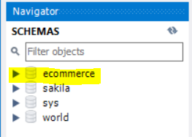
SQL Create database continued…
To validate that your database was created you can execute the following:
SHOW DATABASES;
Or
By looking for your new database under
‘SCHEMAS’ using Workbench.
Notes:
Just show them in Workbench where schemas is, you will need to switch the navigation window from ‘Administration’ to ‘Schemas’.

Slide 47

Activity: Creating our first database
Open up workbench.
Create a new database called ‘Ecommerce’.
Execute the query and verify that the database have been created.
You can execute a query using this icon in Workbench.
Or
You can highlight the query and press ‘ctrl’ + ‘shift’ + ‘enter’.
Notes:
Do this activity with everyone to show them where they can write their query and where they can execute that query.

Slide 48
SQL Drop database
You can delete an existing database with this statement:
DROP DATABASE databasename;
BE CAUTIOUS WHEN IT COMES TO DROPPING A DATABASE. You will lose all information in that database if you drop it!

Slide 49
Activity: Dropping our database
Drop the ‘Ecommerce’ database we created in the previous activity.
Execute the query and verify that the database have been deleted.

Slide 50
SQL Backup database
Why is it important to make regular backups of our database?
Imagine doing research on a topic and putting all your findings in a 100 page document. You need to present your findings the next day and you cannot find this 100 page document. I don’t know about you, but I would probably get a panic attack.
That 100 page document could be extremely valuable to your employer. Loss of data can cause a lot of hardship for a company and it might take a while to recover from that loss.
Notes:
We do not necessarily need to know this for development purposes, but it is still important to point out the importance of making backups of your database.

Slide 51
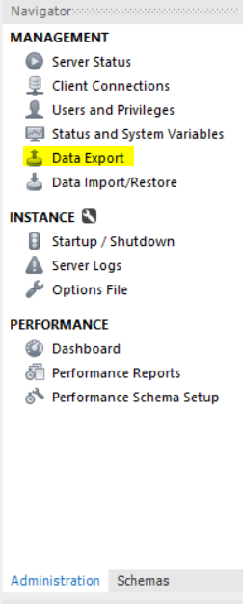
SQL Backup database continued…
You can manually make a backup of an existing
database using Workbench:
In the navigation window in Workbench ensure
the ‘Administration’ tab is selected.
Click on ‘Data Export’.

Slide 52
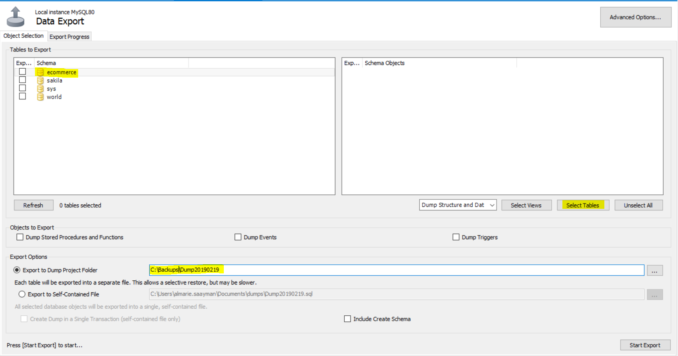
SQL Backup database continued…
Select the database you want to backup.
If our database had any tables they would
show in the right pane.
Click the ‘Select Tables’ button, and ensure the ‘Export to Dump Project Folder’ location is correct. Then click ‘Start Export’.

Slide 53
SQL Backup database continued…
You can verify if the backup was created by
navigating to the directory you specified.
Back up the database to a different computer/drive or even the cloud. Therefore if something happens your data will be safe.
Notes:
Cloud and another PC are probably the best way to go, provided that they are secure.

Slide 54
Activity: Backing up our database
Create a new database called ‘Ecommerce’.
Create a backup of your database on any drive you like (since this is just for practice)
Verify that the database have been backed up by navigating to the location you specified.
Notes:
Currently the backup would not have backed up anything since we do not have tables in our database yet.
Do a brief live illustration of backing up a database containing tables. You can make a back up of the database you created during the showcase.

Slide 55
What will we cover in the next SQL lesson?
Creating tables, data types and constraints.
Primary keys and how to link tables with foreign keys.
The above content might vary depending on our research and preparation of the lesson.

Slide 56
Links
https://www.mysql.com/
https://www.xaprb.com/blog/2008/05/14/mysql-free-software-but-not-open-source/
http://www.catb.org/~esr/writings/cathedral-bazaar/cathedral-bazaar/
https://en.wikipedia.org/wiki/Linus%27s_Law

Slide 57
Big ask: Please do not RSVP yes and then not show up.
Notes:
I understand that this slide is not intended for the people who did show up, but hopefully the word spreads.

Slide 58
Questions?

